Slide 1
Drone Seeker Missile Guidance
Application of Microprocessing
CS230 – Fall 2016, Glendale Community College
Team : Ariful Hoque, Matt Evans, James Zuckerman

Slide 2
System Description
Where is it deployed?
Deployed at Missile Launch Site
Equipped with Rader/Detection System
What it Does?
Determines the Launch Angle for the Missile to intercept the Target Drone
Incorporate a self verification for Target Hit

Slide 3
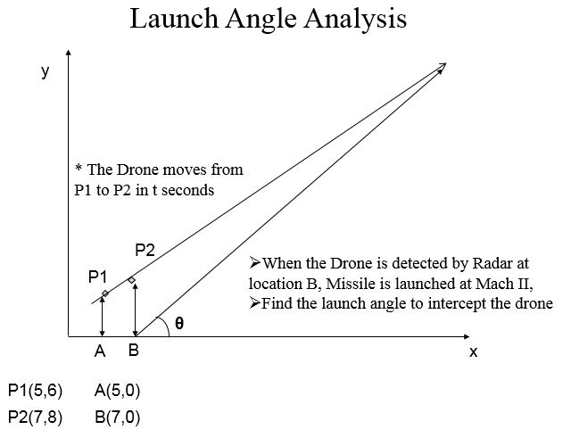
System Concept Diagram

Slide 4
Functional Requirement
Inputs:
Button 1 – start elapsed time
Button 2 – stop elapsed time
Outputs (display @ OLED):
Launch Angle for Missile to intercept the Drone from Location B
Missile Speed set at Mach II (768 mph)
Elapsed Time
Verify Target Hit
Given calculated launch angle and Drone Speed from input data

Slide 5
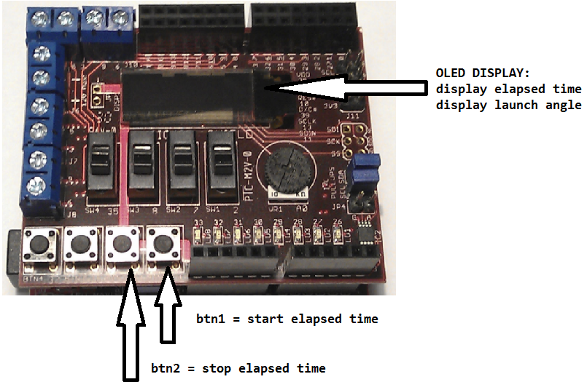
System Block Diagram

Slide 6
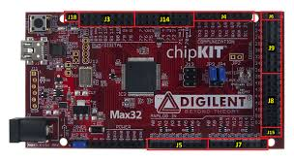
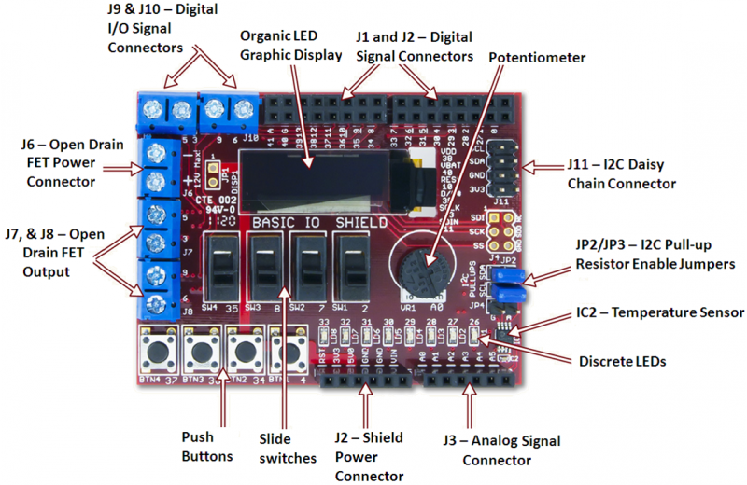
Development Platform
chipKIT™ Max32™ Board :: chipKIT™ Basic I/O Shield Board

Slide 7
Development Platform (Contd.)
Operating System: agnostic
Hardware: input: USB port
Software: MPIDE
Cables: mini USB

Slide 8
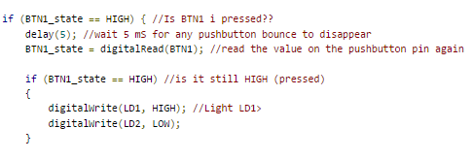
Design Features & Sample Codes
Debouncing a Pushbutton
Source ~ http://chipkit.net/debouncing-pushbutton/

Slide 9
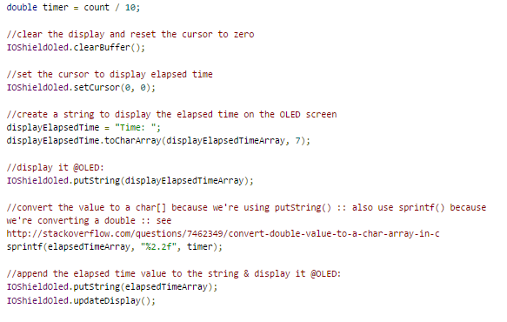
Design Features & Sample Codes
Display elapsed time including milliseconds (tenths only)

Slide 10
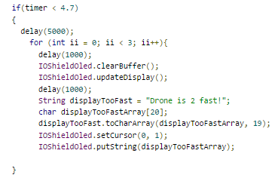
Design Features & Sample Codes
Custom output based on failure to intercept missile
(flashes output)

Slide 11
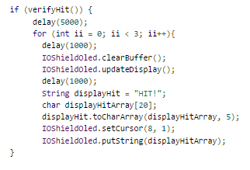
Design Features & Sample Codes
Custom output based on success to intercept missile
(flashes output)

Slide 12
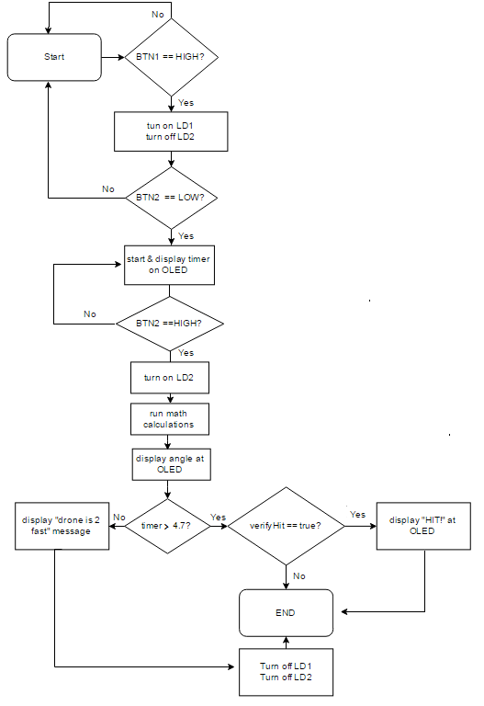
Control Flow Chart

Slide 13
Problems and Solutions
Problems:
How to display double @OLED
Solution – use C library function sprintf() to convert double to char array
How to use switches for timer
Solution – use buttons and nest a while loop inside an if/else
Received NaN Output for angle value when timer was low
Solution – manually calculate angles and find time where drone is too fast.
4.687134 = .99999995942197 = 0.01632237
4.687133 returns NaN.
Output “drone 2 fast” if angle < 4.7 ms.

Slide 14
Problems and Solutions (Contd.)
Problems:
4. Verify application works. Should T2 always match T1 if timer is > 4.7?
4. Solution - verify angle is 29.41 when timer is 15 seconds. Pick random time and manually calculate math and compare to application.
4. Solution – understand variable dependencies for T2
t2 is dependent on d2/v2.
v2 is fixed so that doesn't matter.
d2 is depended on d2x and d2y.
d2y and d2x are both dependent on theta2a.
theta2a is dependent on v1x.
v1x is dependent on v1
v1 is dependent on distance and time

Slide 15
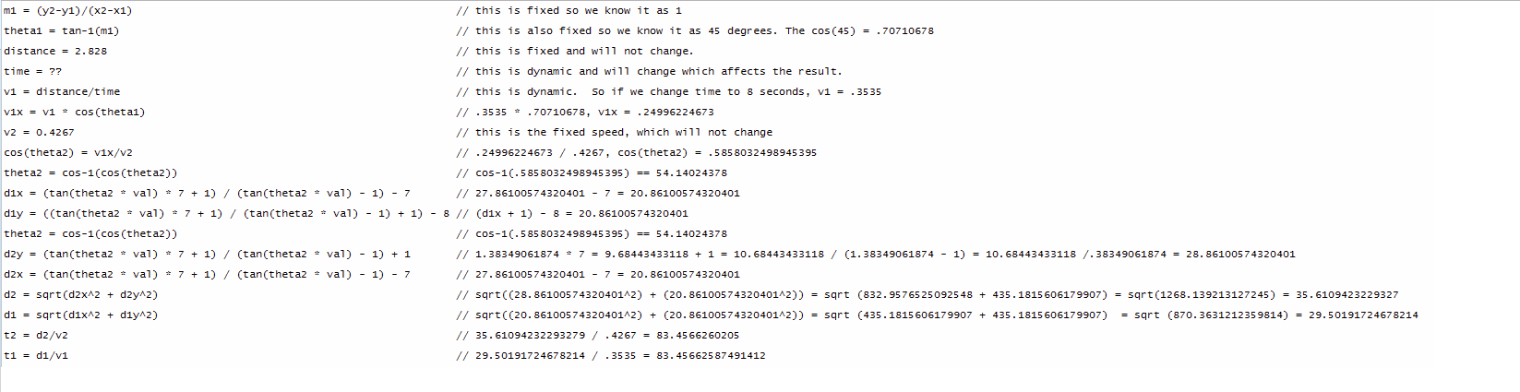
Developer’s Observations & Notes
As noted in Problem #4 it’s important to manually calculate angle using random time and compare it to application. Below is sample of manual math calculation:
When Timer = 8 seconds

Slide 16
Developer’s Observations & Notes
Timer uses tenth milliseconds. For example, 1.10, 1.20, 1.30. It does NOT use hundredths.
Debounce functionality was only implemented for button 1. It was NOT implemented for button 2.
LD1 is assigned button1. LD1 will turn on when button1 is pressed
LD2 is assigned button2. LD2 will turn on when button1 is pressed
LD1 and LD2 will turn off when button1 is pressed after button2 (when you replay).
Variables are set and fetched with Java-like getters and setters

